Slide 1
NLP – Final Project
Korey MacVittie

Slide 2
Overview
Film Review Analysis
11 Films
Last Night (2010); Vanilla Sky; Lost in Translation; Never Let Me Go; Gattaca; American Beauty; Megamind; The Man from Earth; Another Earth; TiMER; 3:10 to Yuma (2007)
Mix of LDA and NMF

Slide 3
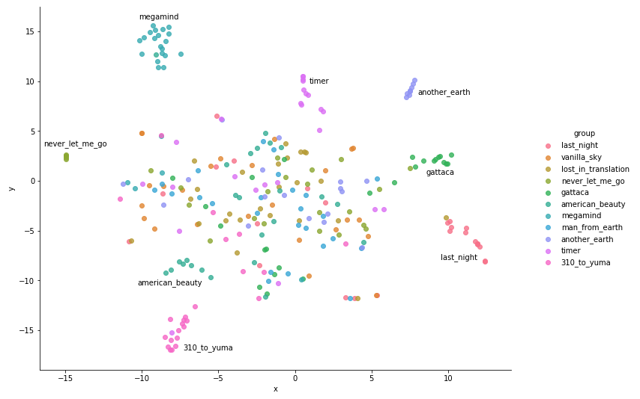
LDA – Scatterplot

Slide 4
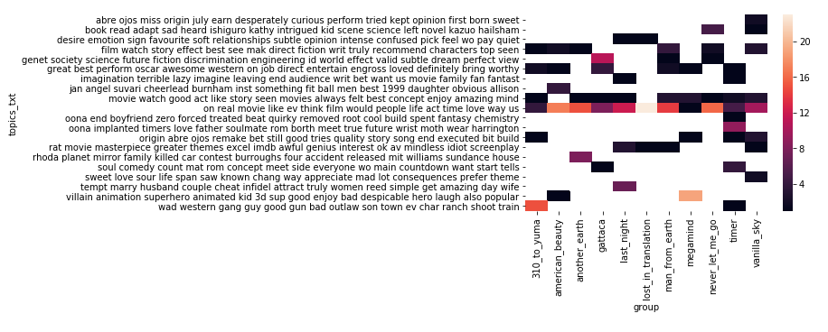
NMF – Heat Map

